Slide 1

AAKASH DHAKSHNAMOORTHY
Beyond apis: building browser-controlling ai agents with ag2

Slide 2

AG2(Auto Gen) Framework

Slide 3
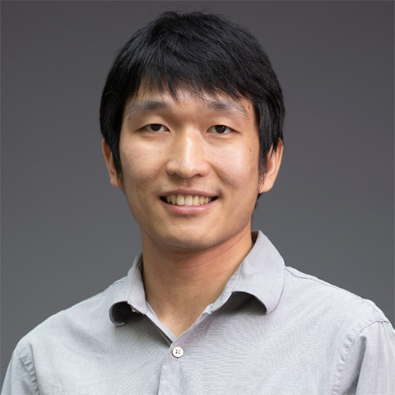
Chi Wang
Principal Researcher, Microsoft Research

Slide 4
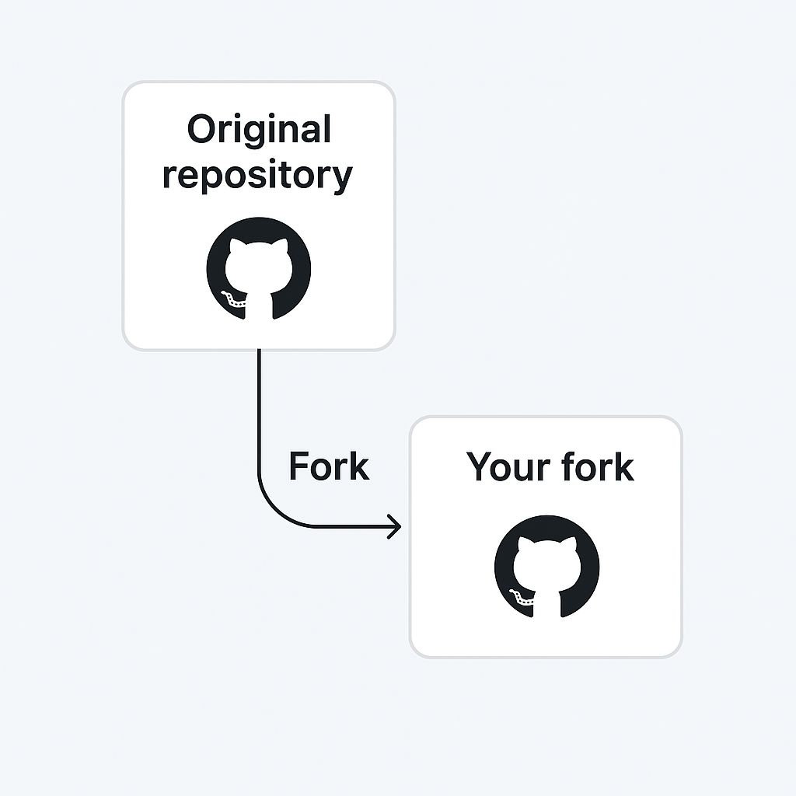
AG2 Framework
This was essentially a community fork.
Wang took the AutoGen 0.2.x codebase (which millions were already using), gave it a new name, switched the license from MIT to Apache 2.0 (which offers stronger commercial protections for contributors and users)

Slide 5
WHAT IS AG2?
ConversableAgent
Orchestration Patterns
The building block
Multiple modes
Every entity in AG2 is a ConversableAgent — can send/receive messages and generate responses using LLMs, tools, or human input.
Two-agent, sequential, group chat, nested chat, and swarm patterns — choose the right model for your workflow complexity.
Human-in-the-Loop
Tool Use
Built-in oversight
Extend capabilities
Seamlessly integrate human judgment at any step. Configure when and how often human input is requested with one parameter.
Register external programs, APIs, and custom functions. Agents invoke tools autonomously and incorporate results into reasoning.

Slide 6
ORCHESTRATION PATTERNS
01
02
03
04
A <-> B
A → B → C
A + B + C
Dynamic handoffs
Two-Agent Chat
Sequential Chat
Group Chat
Swarm / Nested
Simplest pattern. Two agents exchange messages back-and-forth. Ideal for validation, fact-checking, Q&A workflows.
Chain of two-agent chats. Summary of each chat carries forward as context to the next. Good for pipeline workflows.
Many agents collaborate. Supports AutoPattern (LLM picks next speaker), RoundRobin, Random, Manual, and Default patterns.
Agents hand off control based on conditions. Shared context across all agents. Unified into Group Chat in v0.9. Most powerful pattern.
Q&A, fact-checking
Data pipelines, reports
Research, curriculum, design
Customer service, compliance

Slide 7
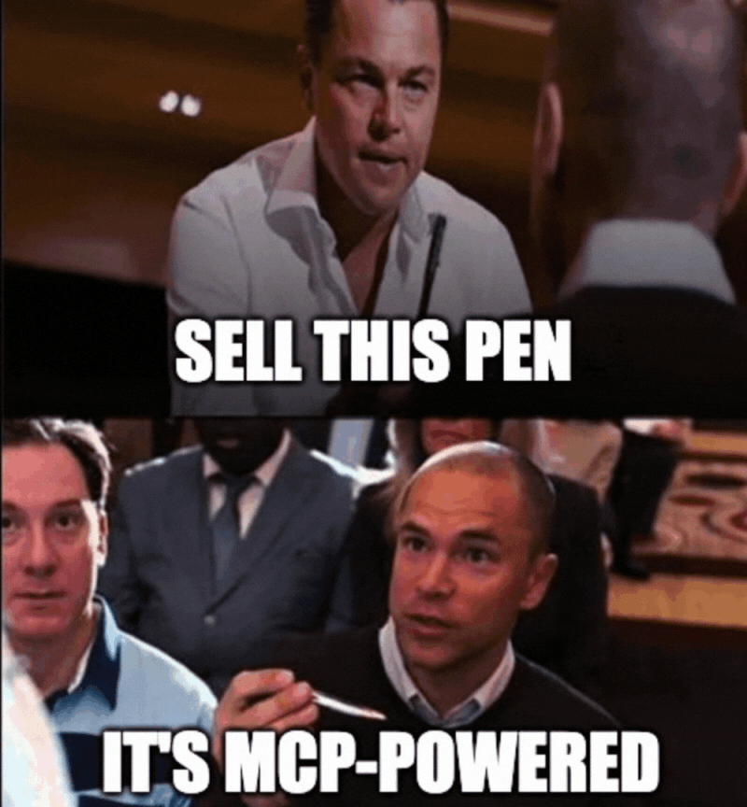
MCP
#AiForGood
March 04, 2023

Slide 8
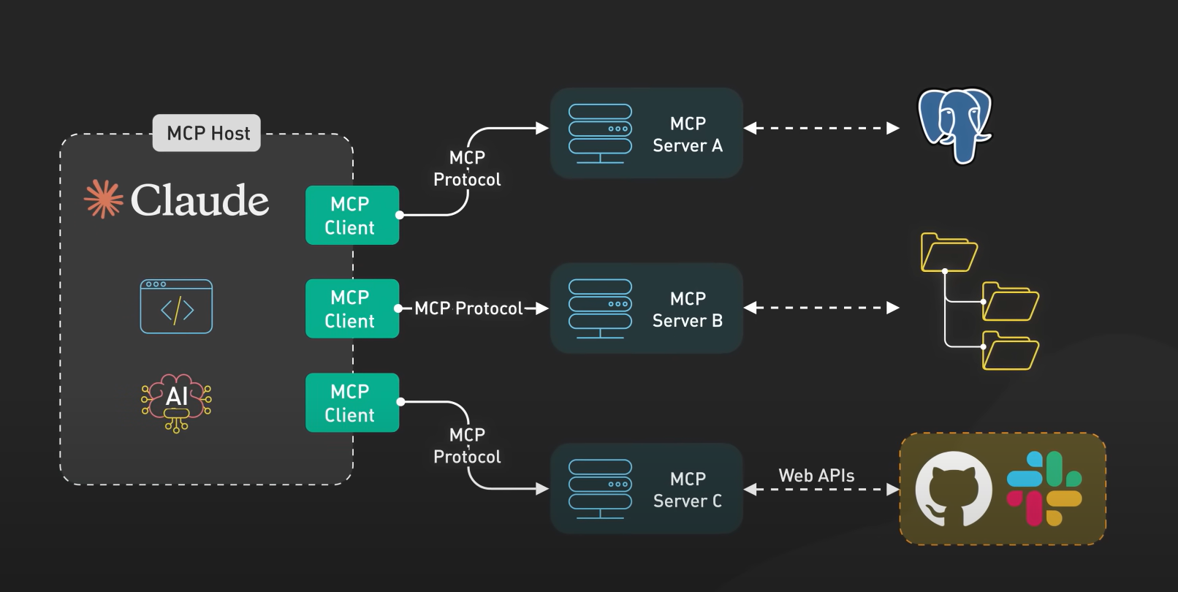
MCP Architecture:
#AiForGood
March 04, 2023

Slide 9
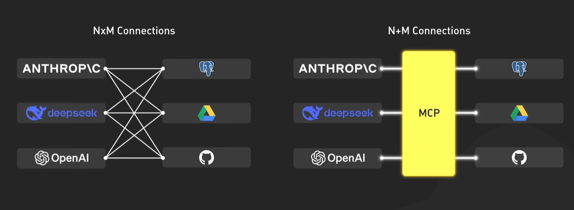
One protocol. Universal standard
March 04, 2023
#AiForGood

Slide 10
CONNECTION LIFECYCLE
01
02
03
04
Handshake
Discovery
Invocation
Shutdown
Client sends initialize with protocol version & capabilities. Server responds. Client sends initialized notification.
Client calls tools/list, resources/list. Server returns its manifest of capabilities. LLM receives this to know what it can use.
LLM decides to call a tool. Client sends tools/call via JSON-RPC 2.0. Server executes and returns typed content (text, image, resource).
No protocol message needed. STDIO: client closes stdin. HTTP: connection closed. Server terminates cleanly.

Slide 11
AG2 + MCP

Slide 12
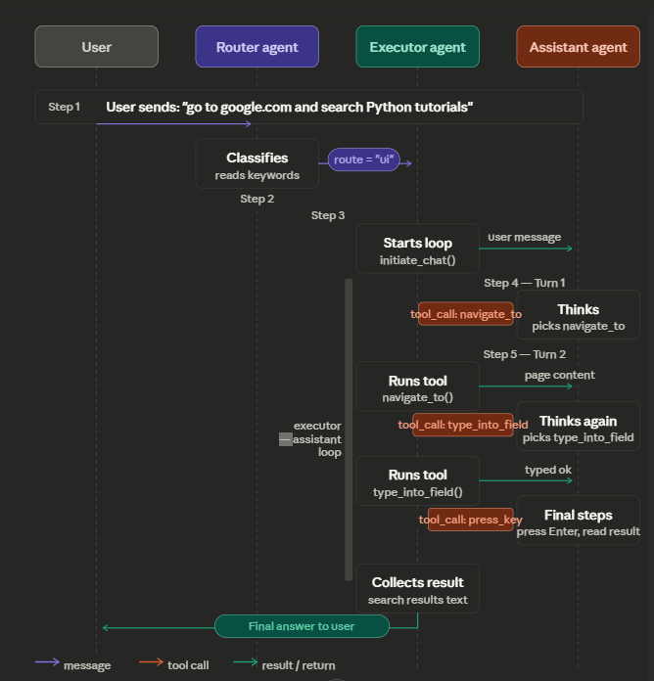
How Ag2 Loop Works

Slide 13
MCP COMPLETE FLOW
Model Context Protocol · Browser Automation · Agent Architecture
"go to google.com, type 'Python tutorials', press Enter, tell me first result"
1. Route
2. Persona
3. Navigate
4. Type
5. Enter
6. Result

Slide 14
STEP 1: ROUTING & PERSONA ASSIGNMENT
👤 User: "go to google.com, type 'Python tutorials', press Enter, tell me first result"
▼
ROUTER AGENT
GPT-4o-mini reads: "go to google", "type", "press Enter"
→ Classifies as: "ui"
▼
SEARCH
UI ✓
CHAT
prices / news
browser actions
general talk
▼
✅ assistant_agent gets UI persona: "Navigate → Read → Click/Type → Enter → Confirm"

Slide 15
STEP 2: navigate_to("https://google.com")
1
Assistant Agent
Tool call: navigate_to("https://google.com")
2
Executor Agent
Runs navigate_to() Python function
3
navigate_to()
mcp.call("chrome", "navigate_page", {url: ...})
4
MCPClient._send()
Writes JSON-RPC to Chrome MCP stdin pipe
5
Chrome MCP
Calls Chrome DevTools → Chrome loads google.com
6
navigate_to()
time.sleep(2) then calls get_snapshot()
7
get_snapshot()
mcp.call("chrome", "take_snapshot") → extract_text()

Slide 16
JSON-RPC 2.0 — HOW PYTHON TALKS TO CHROME MCP
📤 Python → Chrome MCP (stdin)
📥 Chrome MCP → Python (stdout)
{
"jsonrpc": "2.0",
"id": 1,
"method": "tools/call",
"params": {
"name": "navigate_page",
"arguments": {
"url": "https://google.com"
}
}
}
{
"jsonrpc": "2.0",
"id": 1,
"result": {
"content": [
{
"type": "text",
"text": "Navigated to
https://google.com"
}
]
}
}
→
←
MCP LAYER (underneath all browser calls)
Python → MCPClient._send() → JSON-RPC 2.0 over stdin pipe → chrome-devtools-mcp (Node.js) → Chrome DevTools Protocol → Real Chrome Browser
"Google | Search box | I'm feeling lucky | Google offered in: ..."
Each tool call = one JSON-RPC request/response cycle over subprocess pipes

Slide 17
COMPLETE FLOW SUMMARY
MCP LAYER (underneath all browser calls)
Python → MCPClient._send() → JSON-RPC 2.0 over stdin pipe → chrome-devtools-mcp (Node.js) → Chrome DevTools Protocol → Real Chrome Browser
Each tool call = one JSON-RPC request/response cycle over subprocess pipes

Slide 18
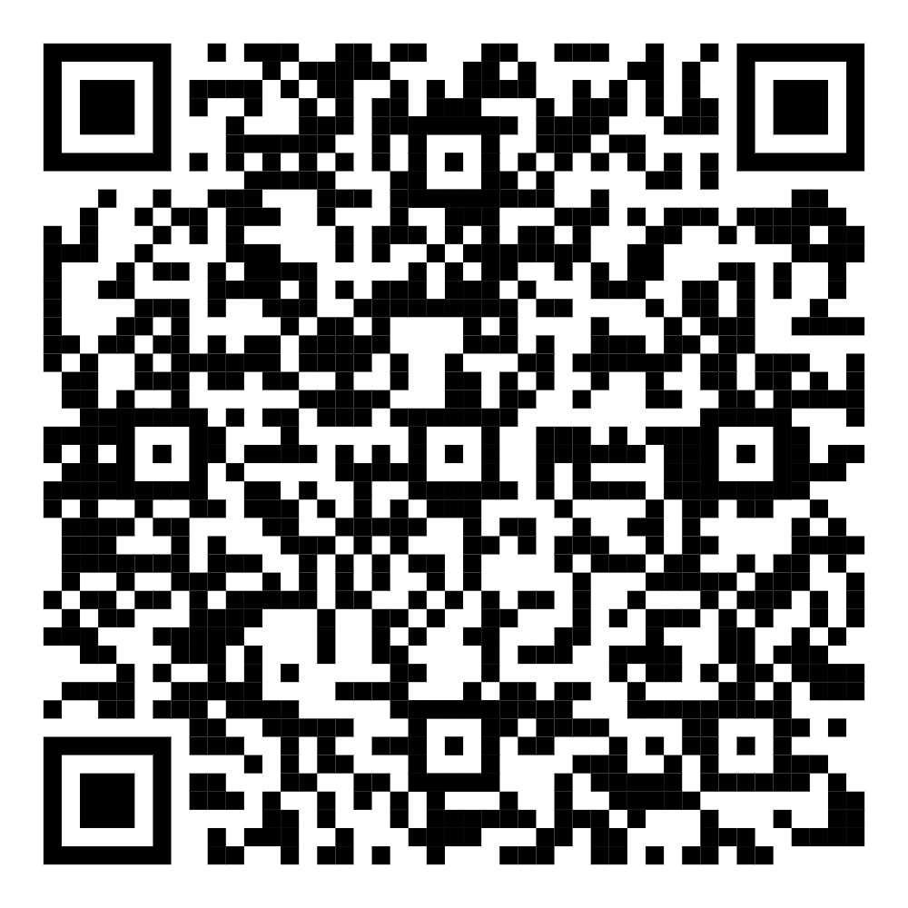
THANK YOU
CONNECT ME HERE

